Slide 1

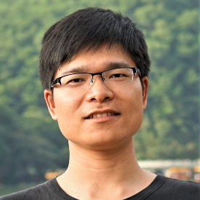

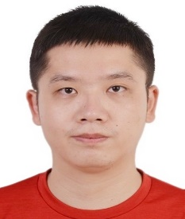




MSR-GCN: Multi-Scale Residual Graph Convolution Networks for Human Motion Prediction
Lingwei Dang$^{1}$, Yongwei Nie$^{1∗}$, Chengjiang Long$^{2}$, Qing Zhang$^{3}$, Guiqing Li$^{1}$
$^{1}$South China University of Technology, $^{2}$JD Finance America Corporation, $^{3}$Sun Yat-sen University
Notes:
Hello everyone. In this paper, we introduced a novel framework titled DOA-GAN for detecting and localizing copy-move manipulation in images.

Slide 2
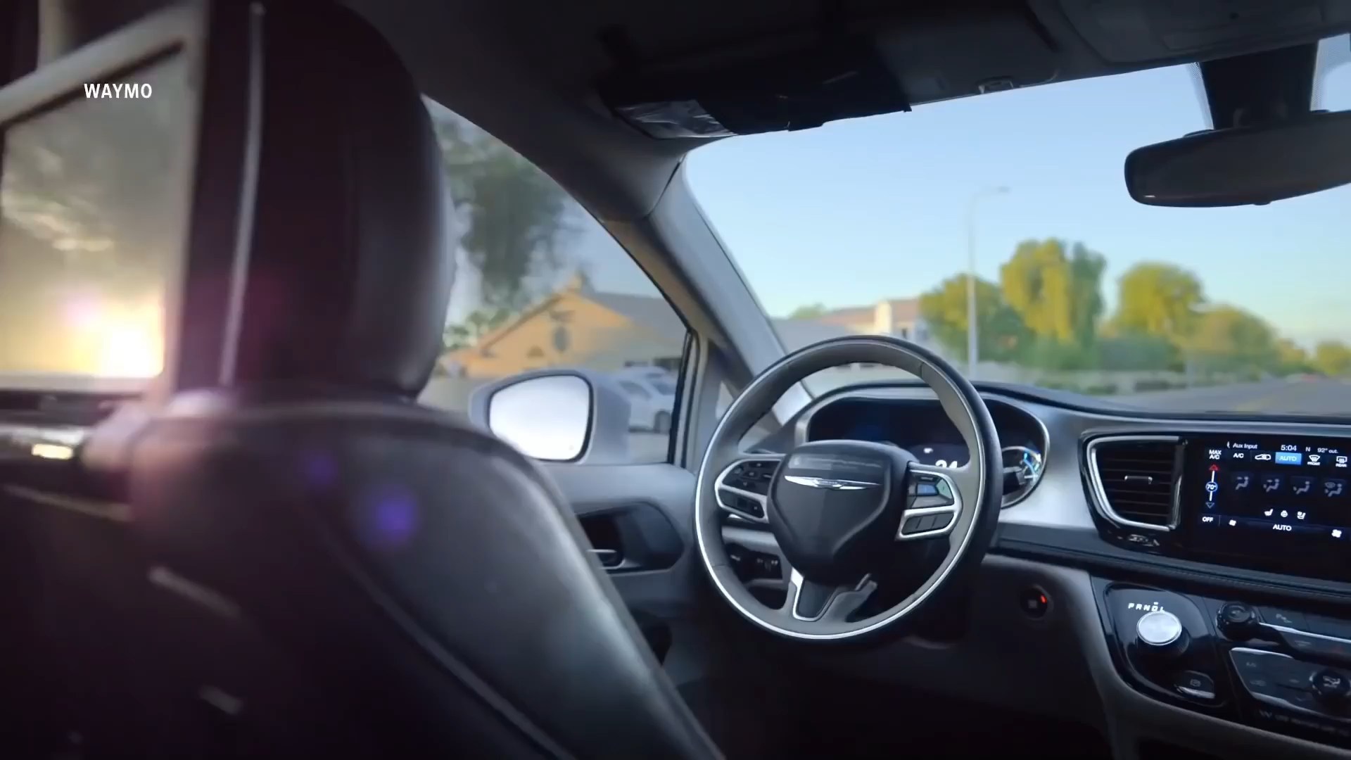
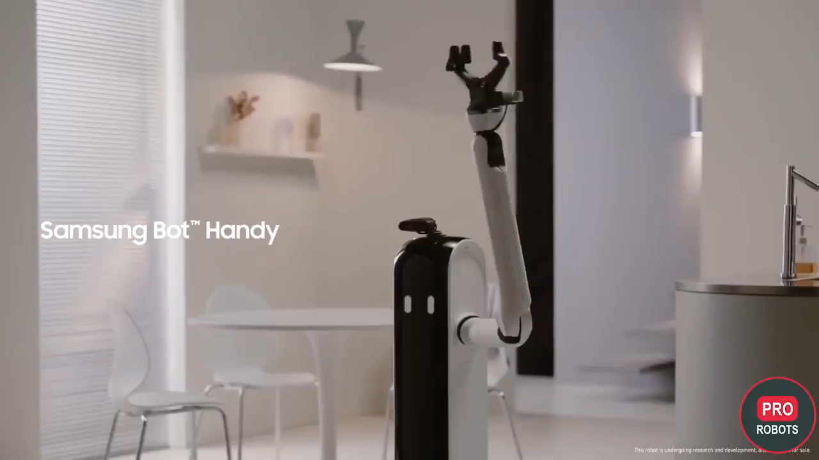
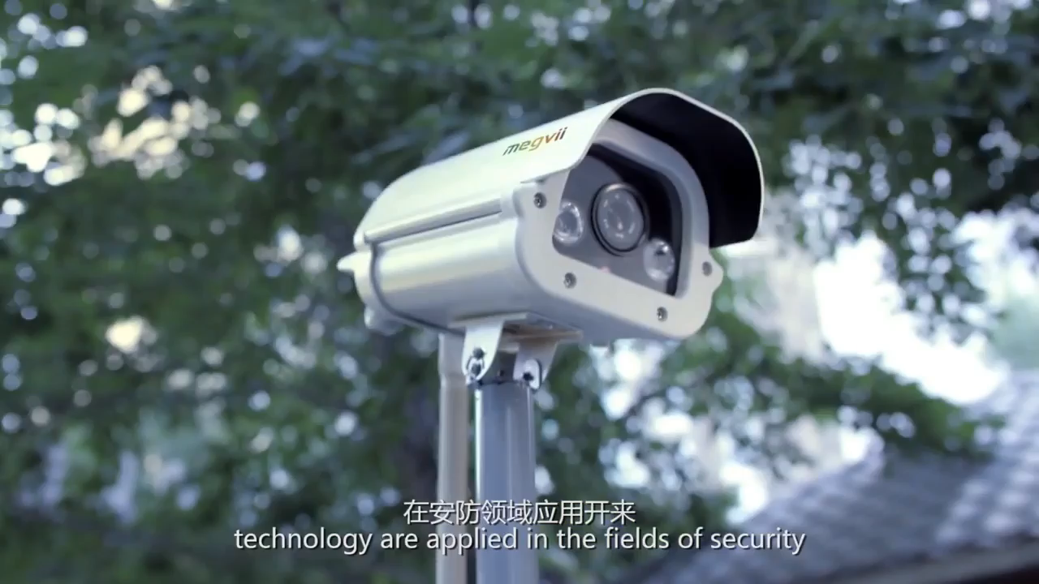
Applications
autonomous driving
human-computer interaction
intelligent security
Notes:
In copy-move manipulation, a source region is copied to another location in the same image. Our goal is to localize and differentiate both source and forge regions.

Slide 3
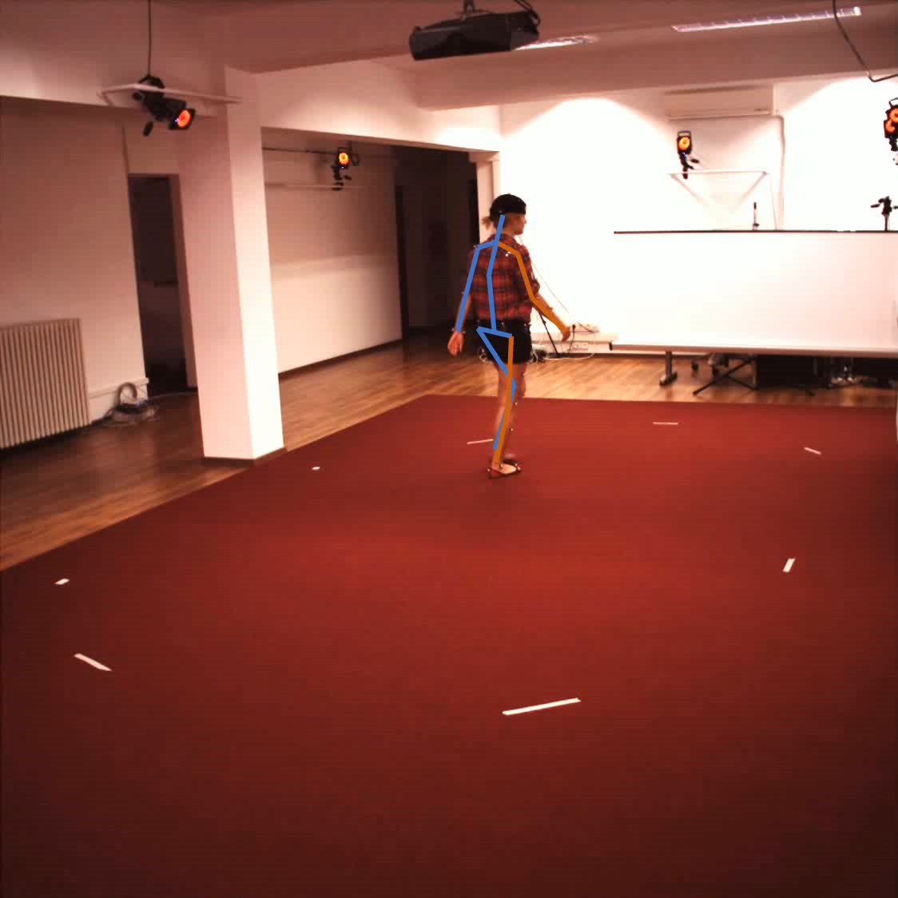
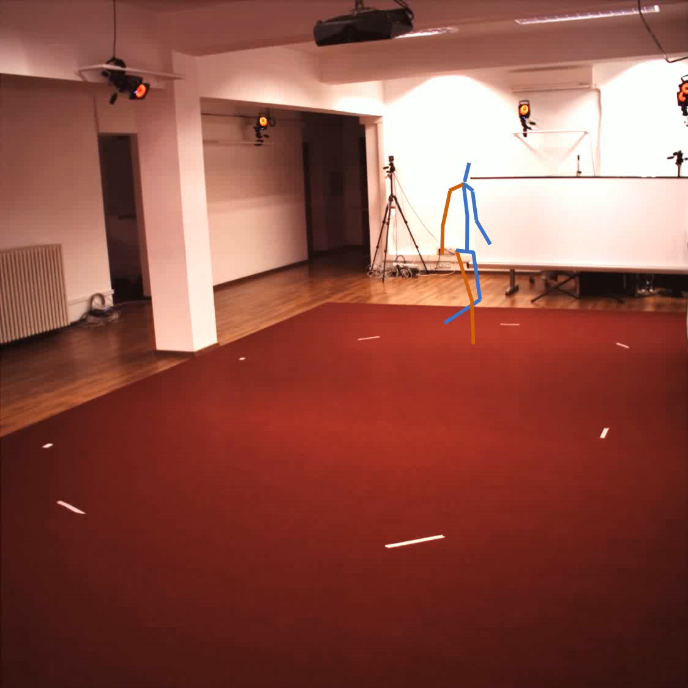
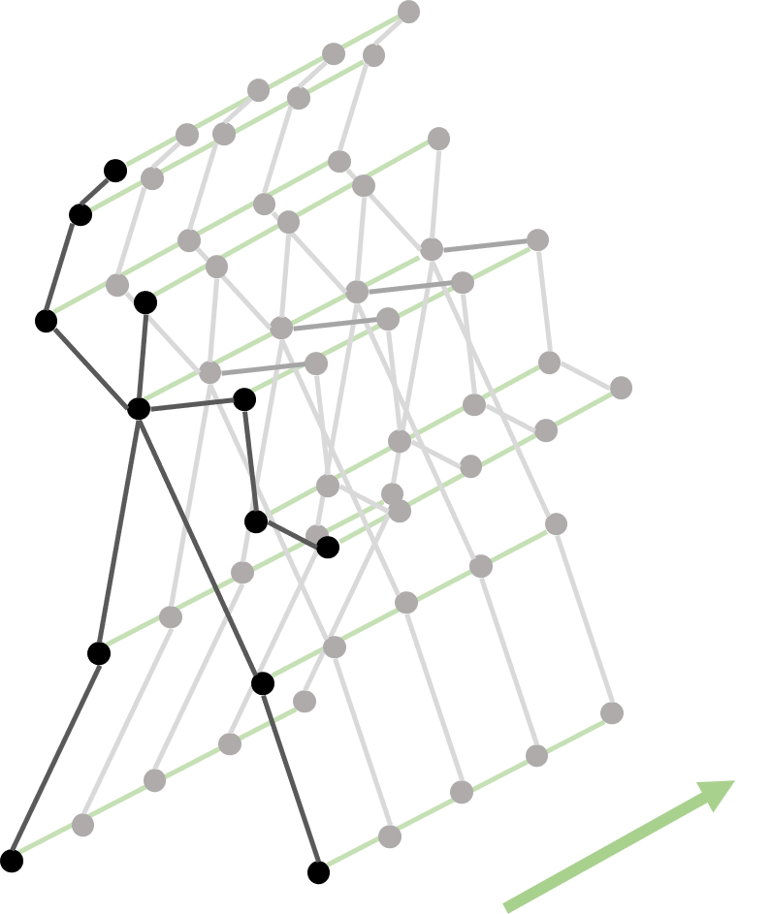
Introduction & Problem
Temporal
Observed Seq
Future Seq
spatiotemporal dependencies
Notes:
In copy-move manipulation, a source region is copied to another location in the same image. Our goal is to localize and differentiate both source and forge regions.

Slide 4
Related Works
Prior efforts neglect the inner-frame kinematic dependencies
Frame-by-frame prediction manner causes error accumulation
Graph Convolution Networks (GCNs) exhibit promising results, but not sufficient for more high-quality human motion prediction.
Notes:
In copy-move manipulation, a source region is copied to another location in the same image. Our goal is to localize and differentiate both source and forge regions.

Slide 5
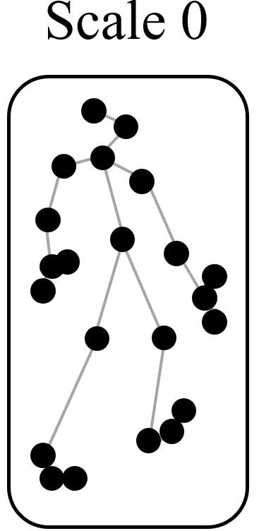
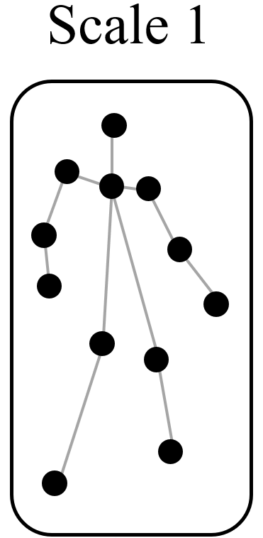
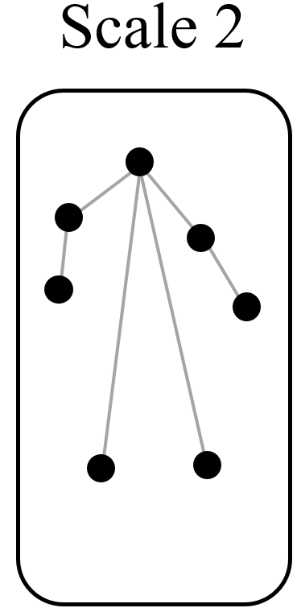
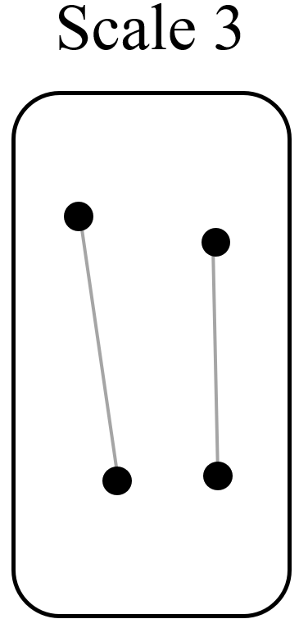
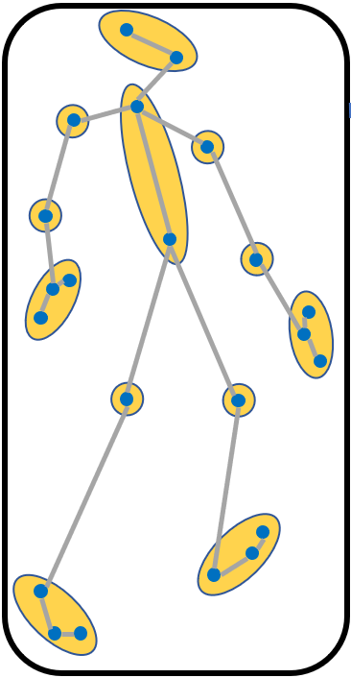
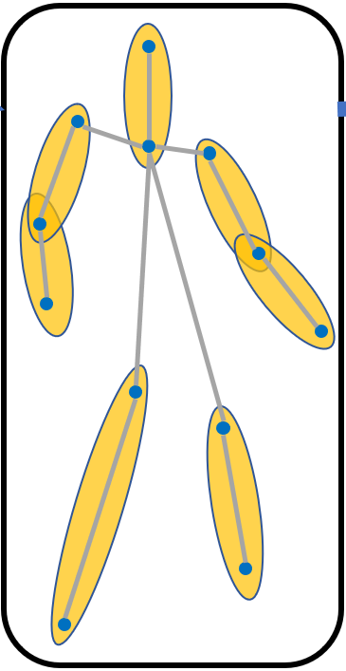
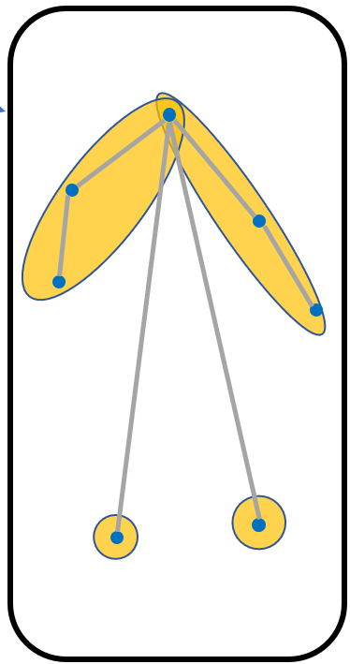
Key Insights
Stabilize the motion pattern by gradually abstracting body parts
Predict the poses in the coarsest level firstly, and then go up to finer levels gradually
multi-scale joints groping manner from finer levels (left) to coarser levels (right)

Slide 6
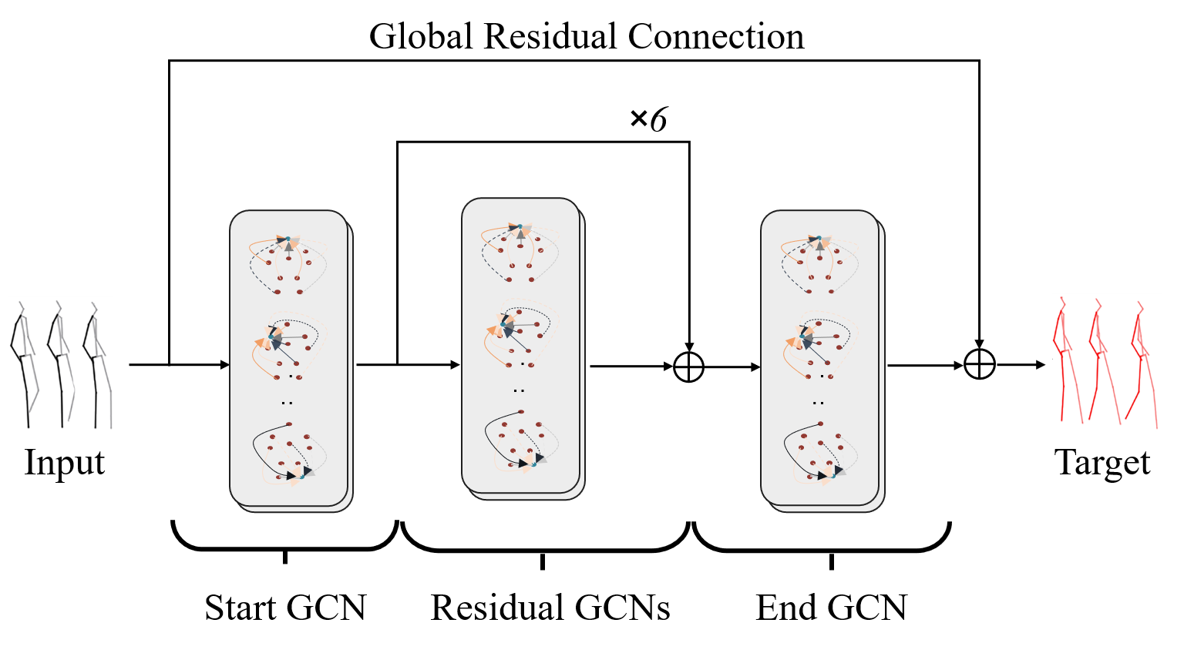
Key Insights
GCNs based on learnable fully connected graph
Start GCN, Residual GCNs, End GCN
Residual connection helps to simplify the prediction process
the basic GCN model

Slide 7
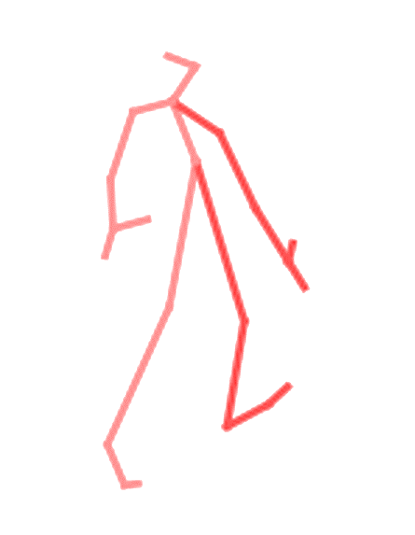
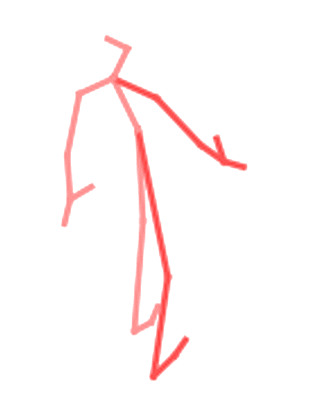
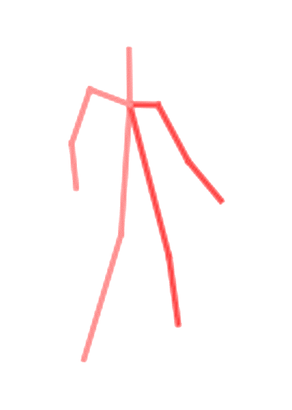
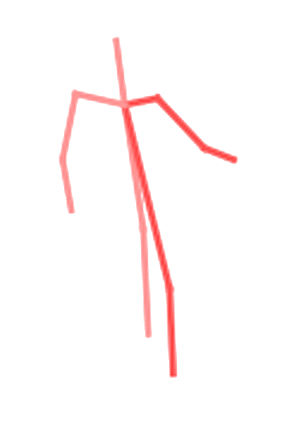
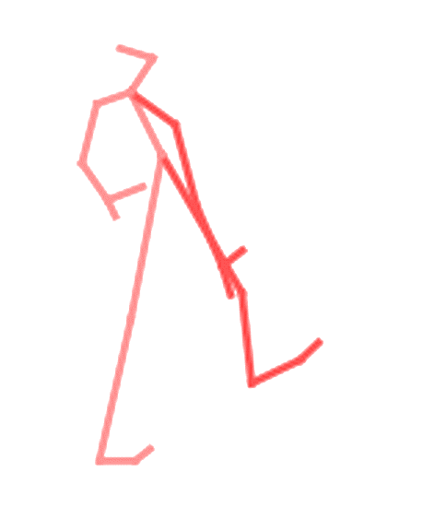
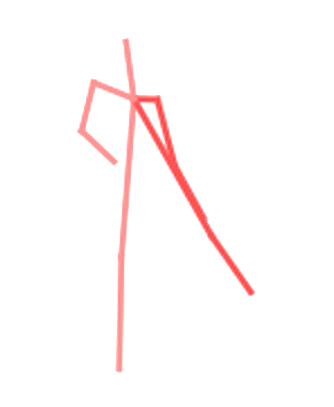
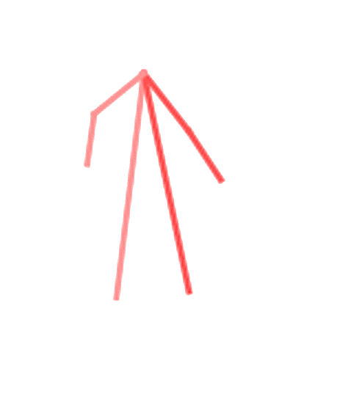
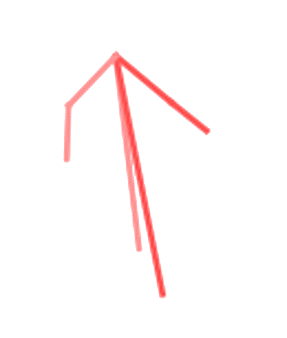
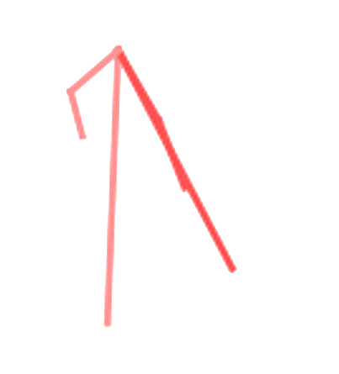
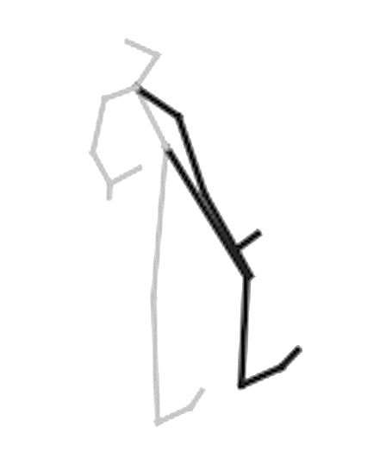
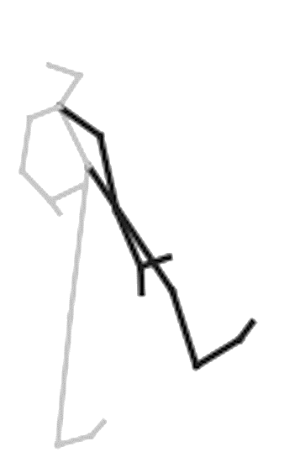
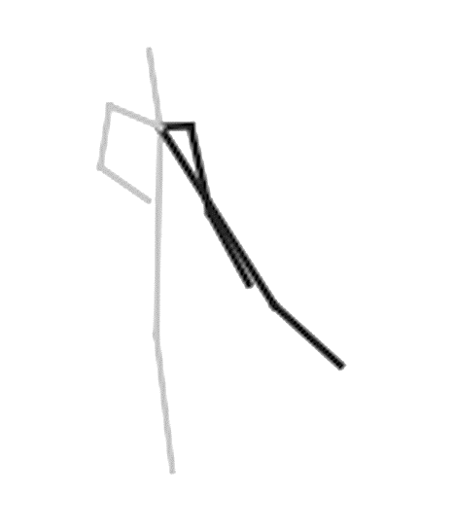
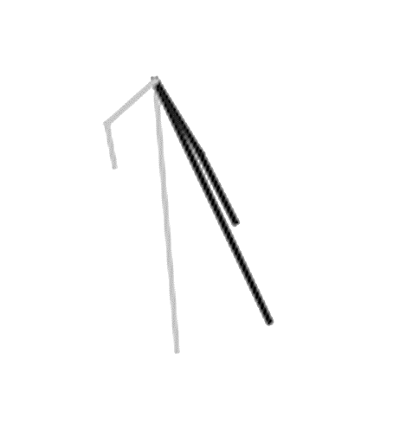
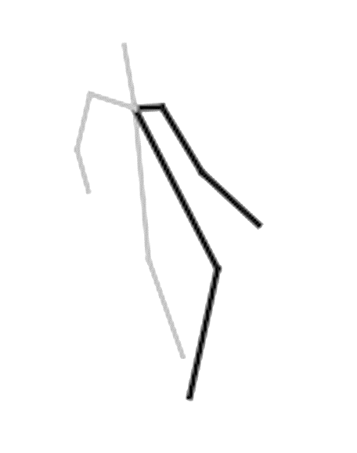
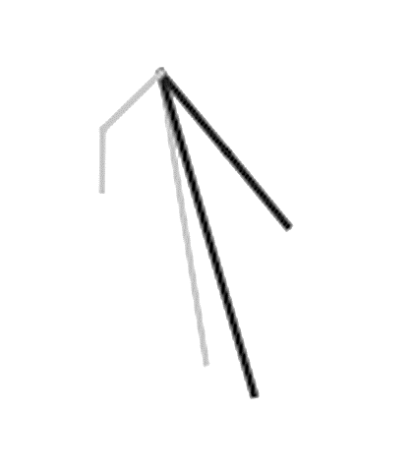
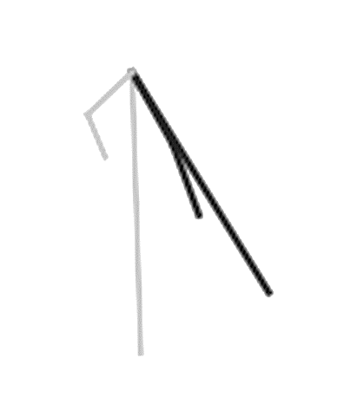
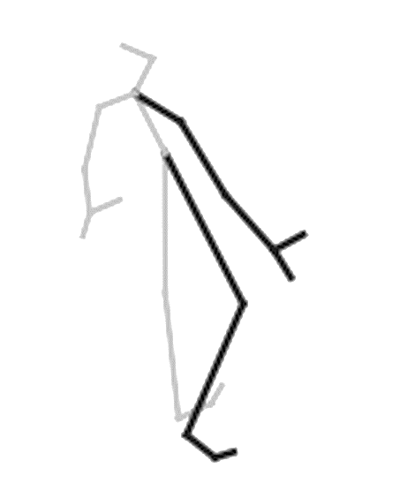
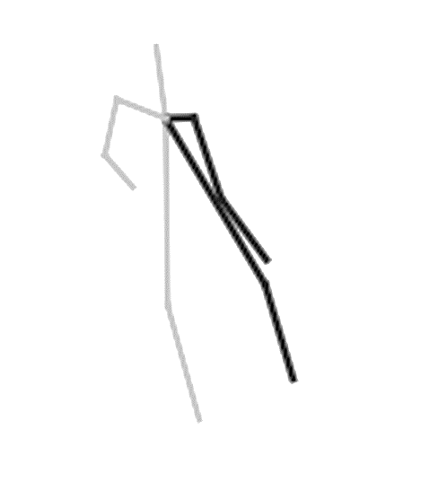
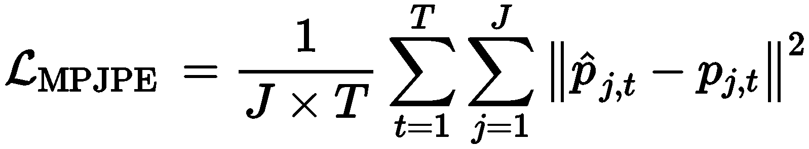
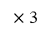
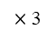
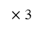
MSR-GCN Architecture
D0
$×$ 3
D2
$×$ 3
$×$ 3
Start GCN
…
D3
Down
Down
Descending Path
Ascending Path
End GCNs and Intermediate Loss
Residual Connections
Target
E0
E2
…
E3
Input
loss function:
Mean Per Joint Position Error (MPJPE)
Scale 0
A0
Scale 2
A2
Scale 3
up
…
up
A3
$×$ 3
$×$ 3
$×$ 3
up
Upsample Layer
Down
Downsample Layer
Elementwise Adding
GCN Block
Descending Path
Ascending Path

Slide 8
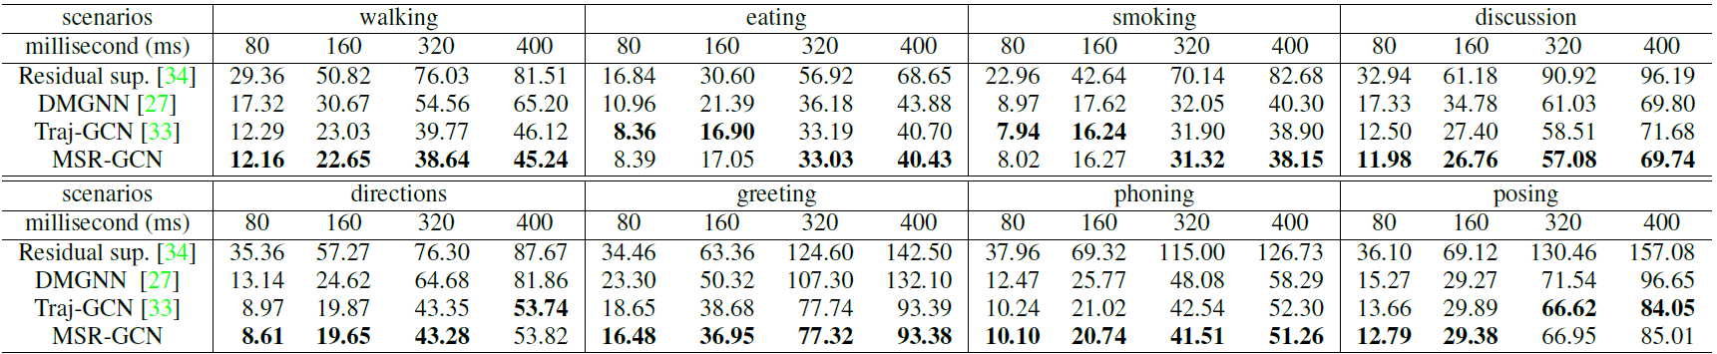
Quantitative Results
Short-term errors on Human3.6M (H3.6M)
Residual sup. Martinez J, et al., CVPR 2017
DMGNN Li M, et al., CVPR 2020
Traj-GCN Mao W, et al., ICCV 2019

Slide 9
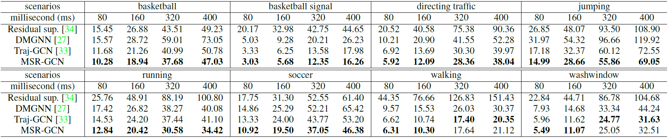
Quantitative Results
Short-term errors on CMU Mocap
Residual sup. Martinez J, et al., CVPR 2017
DMGNN Li M, et al., CVPR 2020
Traj-GCN Mao W, et al., ICCV 2019

Slide 10
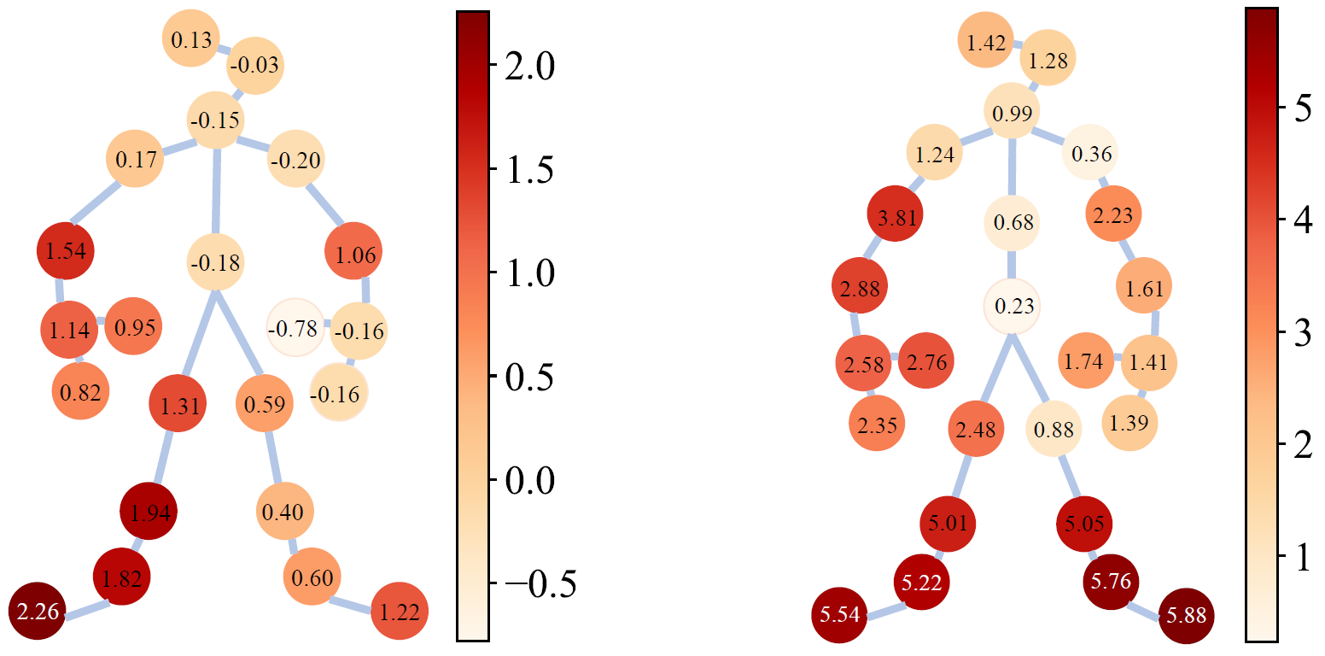
Quantitative Results
Short-term errors on CMU Mocap
H3.6M
CMU Mocap
performance gain over Traj-GCN Mao W, et al., ICCV 2019
MSR-GCN can better handle high-frequency motions

Slide 11
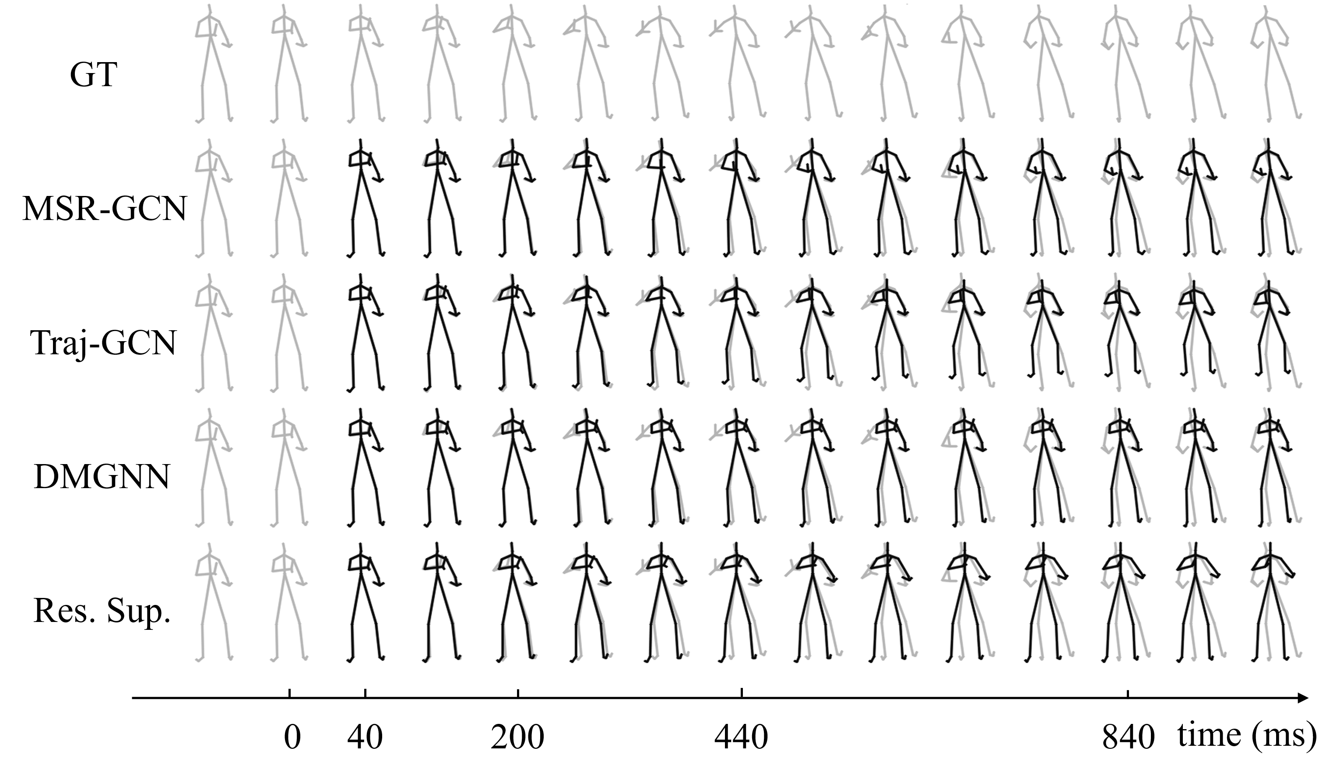
Qualitative Results
Visualization on H3.6M
Traj-GCN Mao W, et al., ICCV 2019
DMGNN Li M, et al., CVPR 2020
Res. Sup. Martinez J, et al., CVPR 2017

Slide 12

QR Code for our project:
https://github.com/Droliven/MSRGCN
Thank you!
Acknowledgement
This research is sponsored in part by the National Natural Science Foundation of China (62072191, 61802453, 61972160), in part by the Natural Science Foundation of Guangdong Province (2019A1515010860, 2021A1515012301), and in part by the Fundamental Research Funds for the Central Universities (D2190670).
Notes:
To know more details about our work, please refer to the paper. Thank you.

